Slide 1
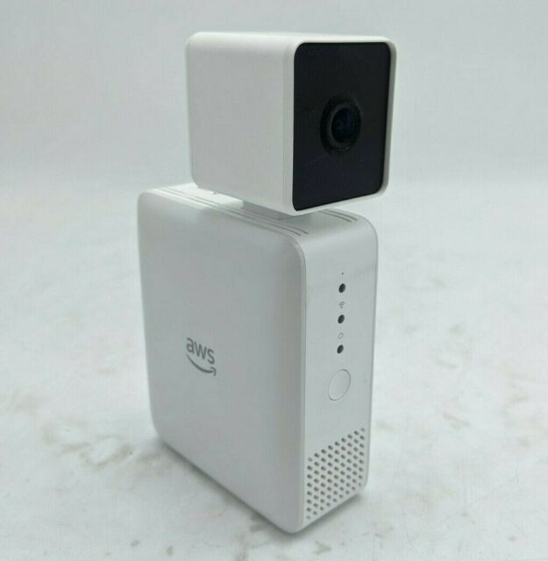
Face Recognition w/h DeepLens
Siyuan Liu
MSDS462 Computer Vision

Slide 2
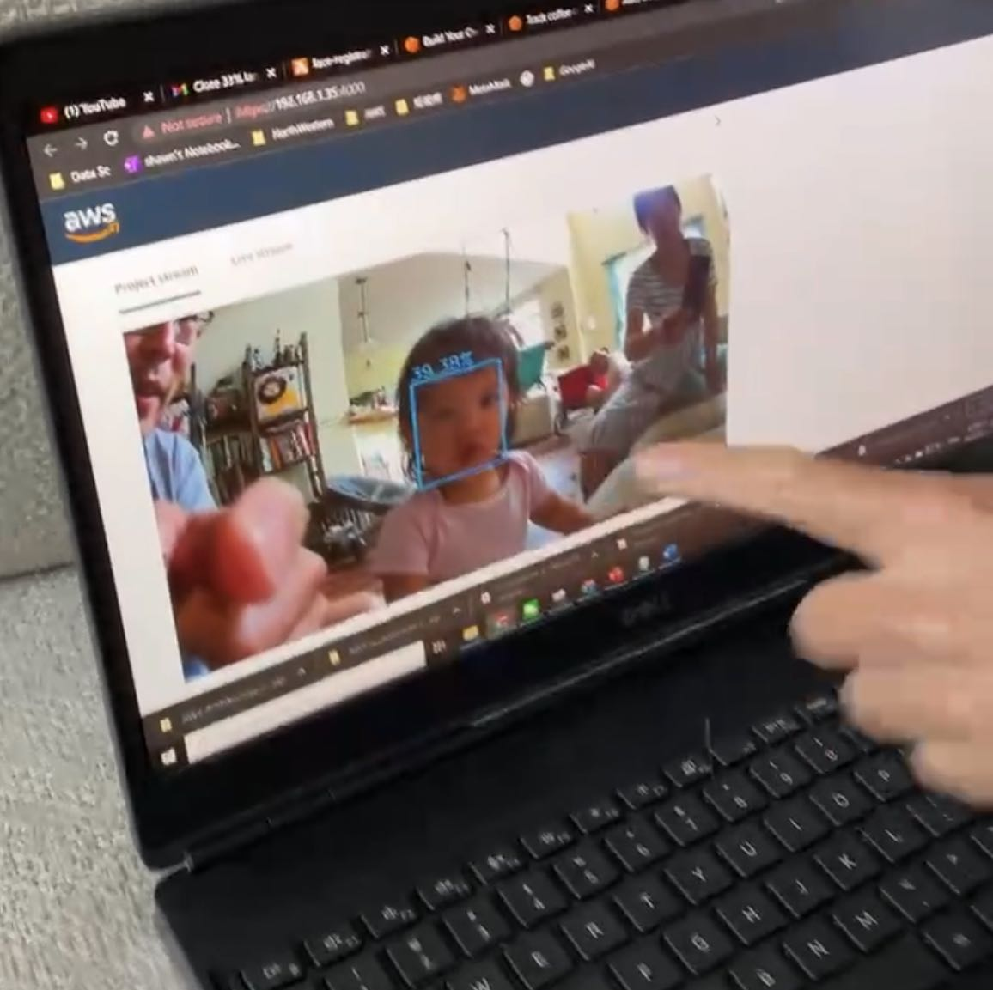
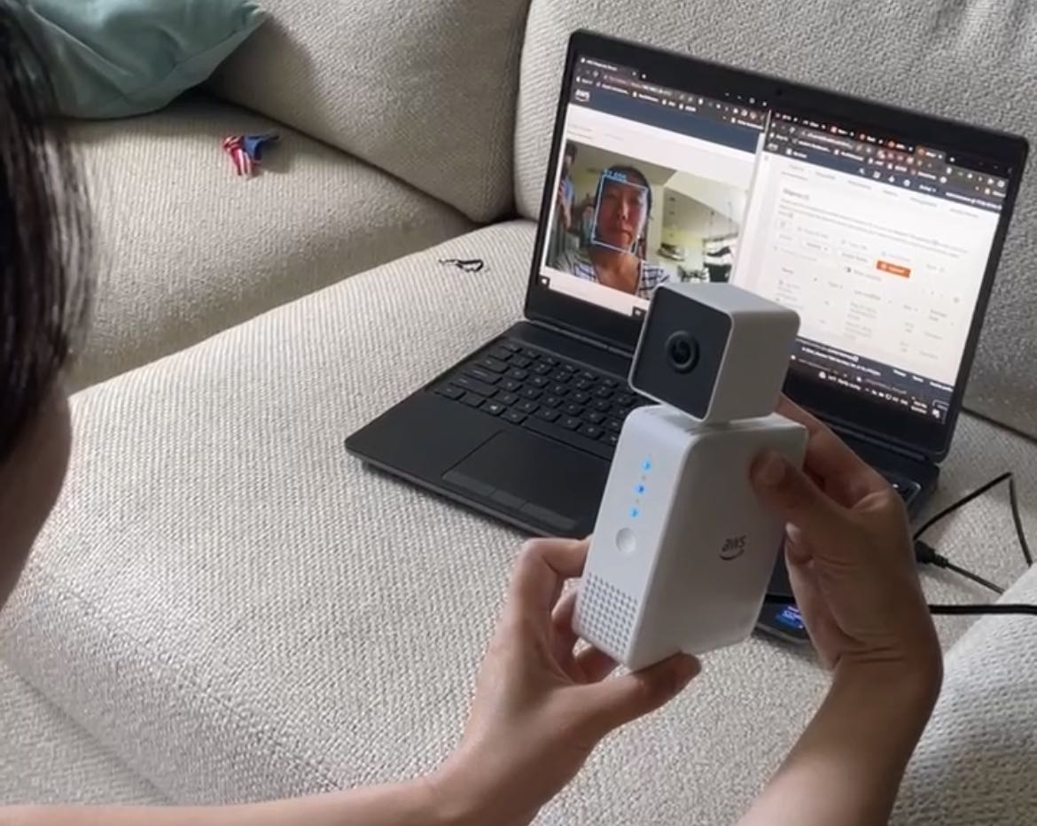
Project Overview
Objective | Develop a computer vision application with capability of detecting and recognizing faces based on ML algorithms and AWS cloud services and deployed the application on Amazon DeepLens on edge
Runtime | Python 3.7 AWS Linux
Features | Detect faces via DeepLens camera Match faces with registered profile Generate welcome message specific to each profile
Services involved | S3, Lambda, Rekognition, SageMaker, S3, GreenGrass (IoT), CloudWatch, Polly, DynamoDB
Potential User Case | Security Entry, Customer Identification, Kids Interaction Game?

Slide 3





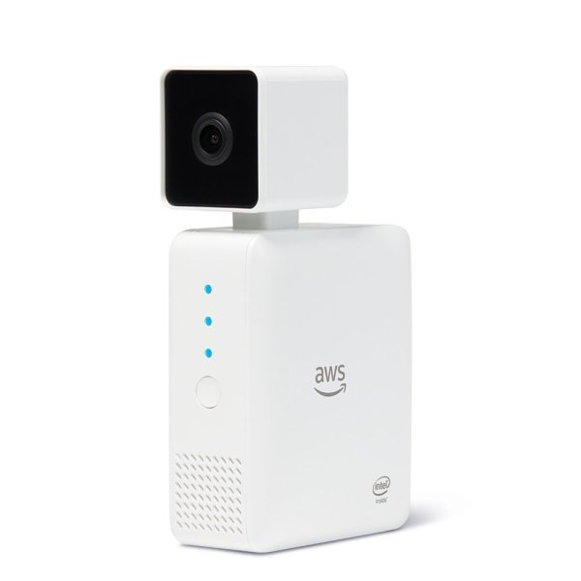



Face Recognition with DeepLens & AWS ML Platform
Edge
AWS Lambda
Amazon S3
Cloud
2. Trigger Lambda
1. Face Detect via DeepLens camera
3. Upload Image
4. Trigger
(S3 PutObject)
AWS DeepLens
9. Upload MP3
generated
8. Text-to-speech return welcome message
AWS Lambda
Amazon Polly
7. Return matched face to lambda
5. Detect face and match with DynamoDB Collection
Face-registration
6. Fetch Face Id, Full Name
1. Upload face
2. Trigger
(S3 PutObject)
3. Send to image analysis
4. Indexed Faces
Amazon S3
AWS Lambda
Amazon Rekognition
Amazon DynamoDB

Slide 4
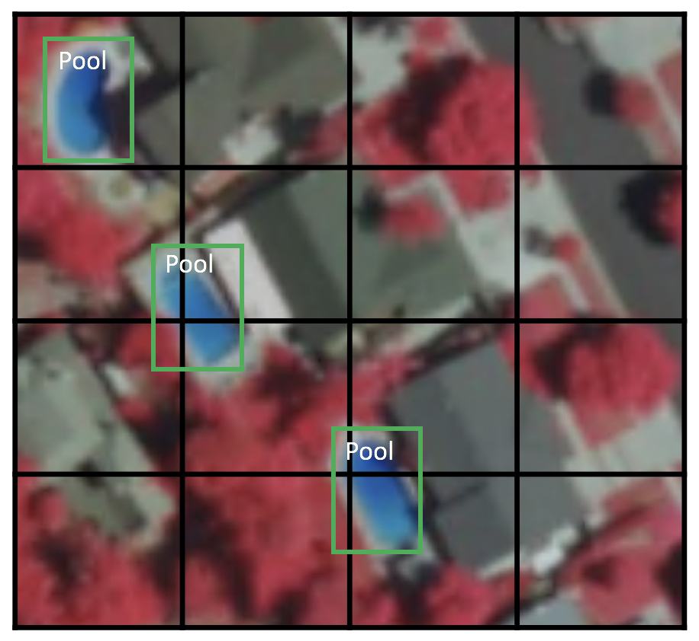
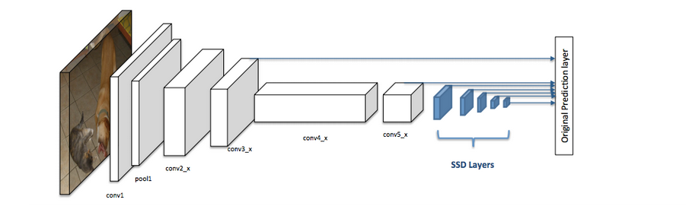
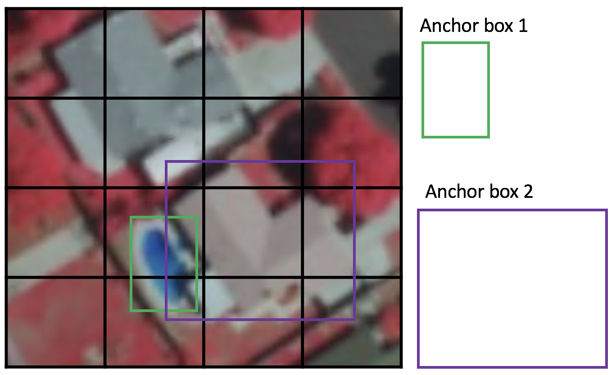
Face Detection Model
SSD divides the image using a grid and have each grid cell be responsible for detecting objects in that region of the image. Detection objects simply means predicting the class and location of an object within that region. If no object is present, we consider it as the background class and the location is ignored
Single-Shot Detector (SSD)
SSD uses a matching phase while training, to match the appropriate anchor box with the bounding boxes of each ground truth object within an image. Essentially, the anchor box with the highest degree of overlap with an object is responsible for predicting that object’s class and its location. This property is used for training the network and for predicting the detected objects and their locations once the network has been trained
Source:https://developers.arcgis.com/python/guide/how-ssd-works/
Backbone
Usually a pre-trained image classification model trained on ImageNet from which the final fully connected classification layer has been removed, In this project ResNet50 used
SDD Head
One or more convolution layers added to the backbone, the output are interpreted as bounding box and object classes in the spatial location

Slide 5
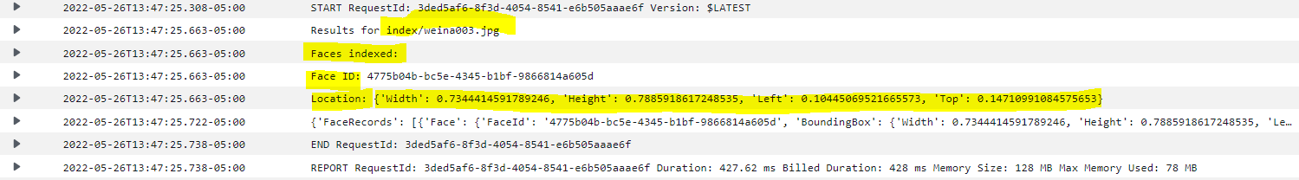
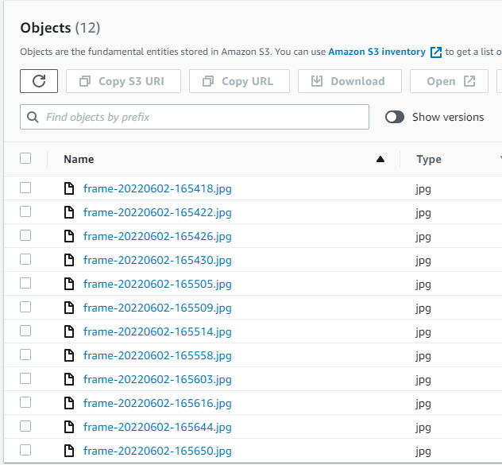
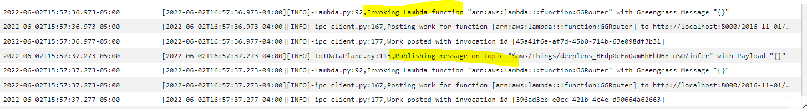
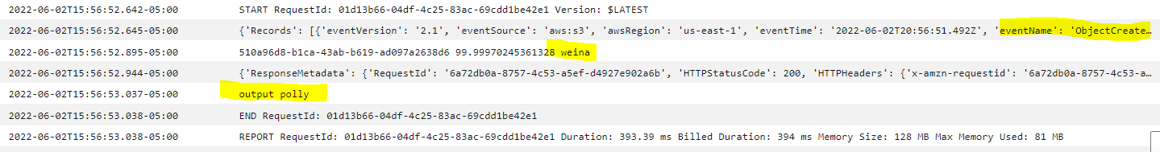
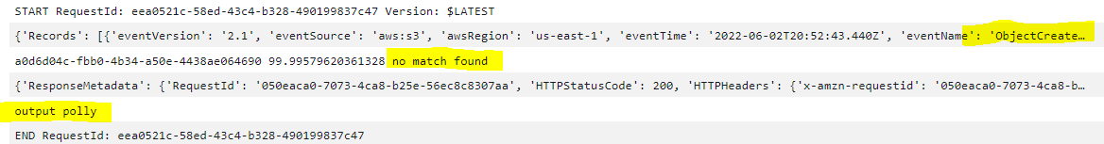
Output Logs
1
Face images were analyzed through Rekognition service and pre-registered in DynamoDB collection
2
Face image captured by DeepLens and uploaded to S3 in every 30s
3
Rekognition compared uploaded image with indexed faces registered and return the label if match found

Slide 6
Future Work
Extend the Face Registration process into front-end web application to be more user-friendly
Trained customized model on SageMaker using my own images and deployed on DeepLens so that it can run independently without internet/cloud
Extended functionality and capability to interact with other devices
Connect Alexa-enabled speaker to automatically play the welcome message generated by Polly
Connect to smart lock or control panel of door / garage to allow access/control based on face verification

Slide 7
THANK YOU!

